Slide 1
Rekor & Koji - RIG Presentation
Claire Burkhardt
Research, OCTO Security Co-op

Slide 2
WHAT ARE RPMS AND KOJI?
RPM is both the package manager and the file format for deploying software packages to RHEL and Fedora
RPM files contain headers (lead, signature, and index file metadata) and a payload (CPIO Archive) of the files being installed
The signature header stores a PGP signature if a user signs the package
To verify signature, public keys must be downloaded and stored in the local RPM database, then used to validate the file’s signature header
Koji is the RPM build system for the Fedora project, among others

Slide 3
WHAT IS REKOR?
Rekor is a tamper-resistant, time-stamped, immutable ledger of signing metadata
Rekor does not
Prevent private key exposure or identity theft
Ensure signed packages are not malicious
Rekor does
Enable a chain of custody (traceability) by being an external, immutable, and time-stamped source of truth (non-repudiation) that individuals can check signed software against (trust)
Streamlines verification and simplifies key management

Slide 4
Goal:
Through Koji, store RPM signing materials in Rekor in addition to the RPM’s signature header
Why?
External source of truth that’s immutable, time-stamped, and non-repudiable
First step towards improving chain of custody and traceability
Easier verification on user-end

Slide 5
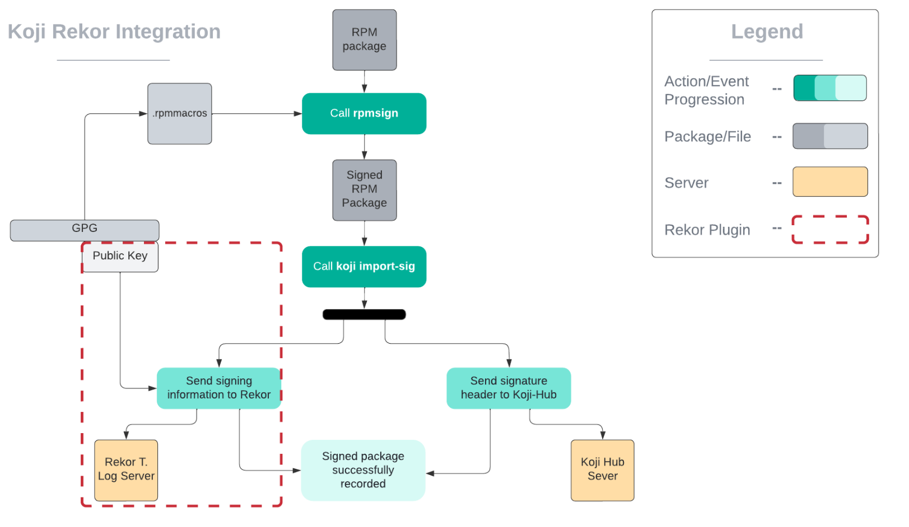

Slide 6
THE PLUGIN
Uploads RPM file signature and metadata into a queryable Rekor server
Enables functionality and policy enforcement
Successful Rekor upload can be optional or required for Koji action to succeed
Entries can be uploaded to the public instance of Rekor or a privately-hosted server

Slide 7
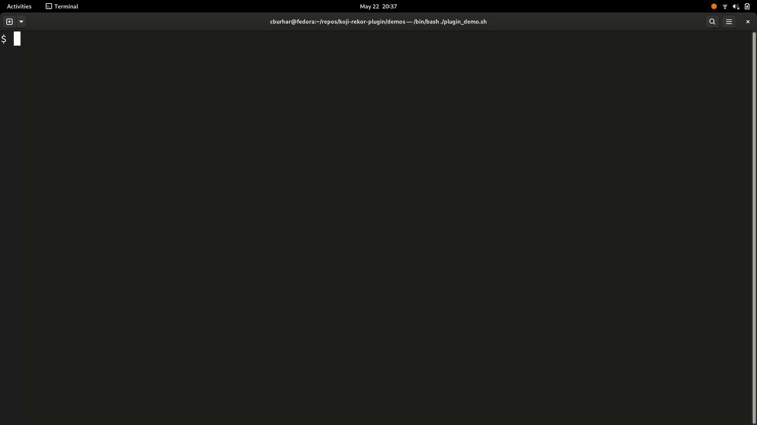
DEMO

Slide 8
NEXT STEPS
Plugin integration into workflows
Developer and user-end
Developing similar tools and integrations (Rekor, Sigstore, etc.) to achieve goal of better supply chain security, including
Full traceability
Distribution/signature monitoring
Streamlined user-end validation

Slide 9
Huge thank you to Luke Hinds, Yesenia Yser, Tom Rix, and Heidi Dempsey for all their support and mentoring!
Thank you, and any questions?

Slide 10
REKOR ATTACK VECTORS
Rekor mitigates
Attack vectors where malicious actors modify unsigned packages (either in the development or production state) and nobody is aware of the modification
Attack vectors where malicious actors modify signed packages that are not routinely verified due to the friction/complexity of doing so
Attack vectors where malicious actors have access to private keys
Rekor does not mitigate
Attack vectors for the Rekor server itself
Server may go down/experience a denial of service attack
Server may be vulnerable to potential exploits to produce a false positive
Regular signature vulnerabilities (eg. private key/OIDC access)
Alerting can mitigate this risk if an individual is notified whenever their ID/email/keys are used to upload a signature to Rekor

Slide 11
TECHNICAL NOTES
What does this change?
Public key file stored in a place accessible to Koji/Brew system
‘koji import-sig’ handles RPM payload in addition to header
This could slow import speed at times of high usage
Exploring options with Michael (Koji/Brew tech lead) and the Rekor team in OCTO-Security

Slide 12
KOJI AND RPM SIGNING
Koji doesn’t natively sign RPMs. The proper mechanism to sign a package is to:
Make a copy of the unsigned RPM
Sign the RPM with ‘rpmsign -–addsig <package>’
Import the signed RPM header to Koji Hub using ‘koji import-sig’
The Koji Hub plugin triggers upon a callback at step three. In addition to importing the signature header to Koji Hub, the plugin uploads the signing materials to the Rekor server and records the receipt in a log.

